Slide 1
No Code Game Editor
Rogue : Meet Your maker
Author: Patrick Donnelly

Slide 2

Introduction
A No Code Game Editor for Roguelike Creation
Focused on User Experience, Accessibility and Simplicity
Featuring Asset Creation/Saving and Level Generation
Primarily SFML and C++, possible changes throughout the process

Slide 3
Research Question
Can a Simple and Accessible User Experience that allows Complex game production be created for people with non-coding backgrounds?

Slide 4
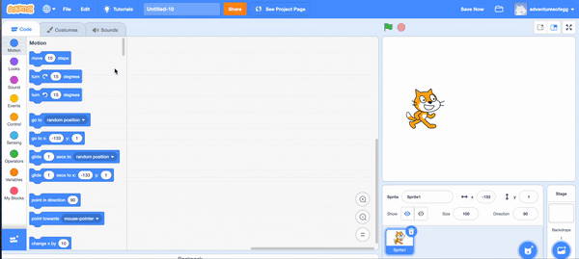
Inspiration
Scratch
Accessibility
No Experience Required
Simplicity
Drag and Drop instant results
User Friendly
User Interface

Slide 5
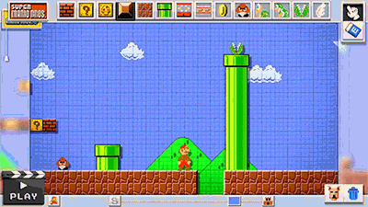
Inspiration
Super Mario Maker
Endless possibilities
Process
Fun – Creation, Playing
Accessible - UI
Seamless Transitions
Editing
Play testing

Slide 6
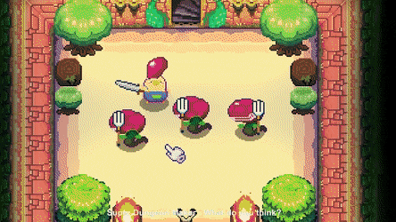
Inspiration
Super Dungeon Maker
Versatility
Assets
Simplicity
Drag and drop Creation
Accessible
Complex Mechanics made easy for the player

Slide 7

Motivation
Creating something :
Fun
Accessible
User Friendly
Allows Users with no coding background to enjoy game creation

Slide 8

Focus
User Experience
Simple Accessible User Interface
Detailed easy to understand user feedback throughout the creation process
Fun not limited to playing your creation but building it too.

Slide 9

Technology Stack
Current Build Includes
Visual Studio
C++
SFML
Further Research Needed :
Yaml
Json
Other
Appropriate Parser
Subject to change as project Progresses

Slide 10

Project Schedule
Sprint 1 – 3: Create a prototype
Prototype Features :
Place Walls
Resize Grid Space
Validate Rooms
Generate Floor Space
Assign Colliders to wall Sets
Player Placement and Movement
Object Placement
Player Object Interaction
Collision
Destruction
Push

Slide 11

Project Schedule
Beyond the Prototype
Features:
Saving and Loading a room
User Interface
Room Placement to Create Floors
Procedural Generation using User Created Rooms
Game Creation based on:
Room Placement
Procedural Generation
Assigning Behaviour types to Objects
Audio Management
QoL Features
Balancing the game, Setting User Limitations, Optimisation

Slide 12
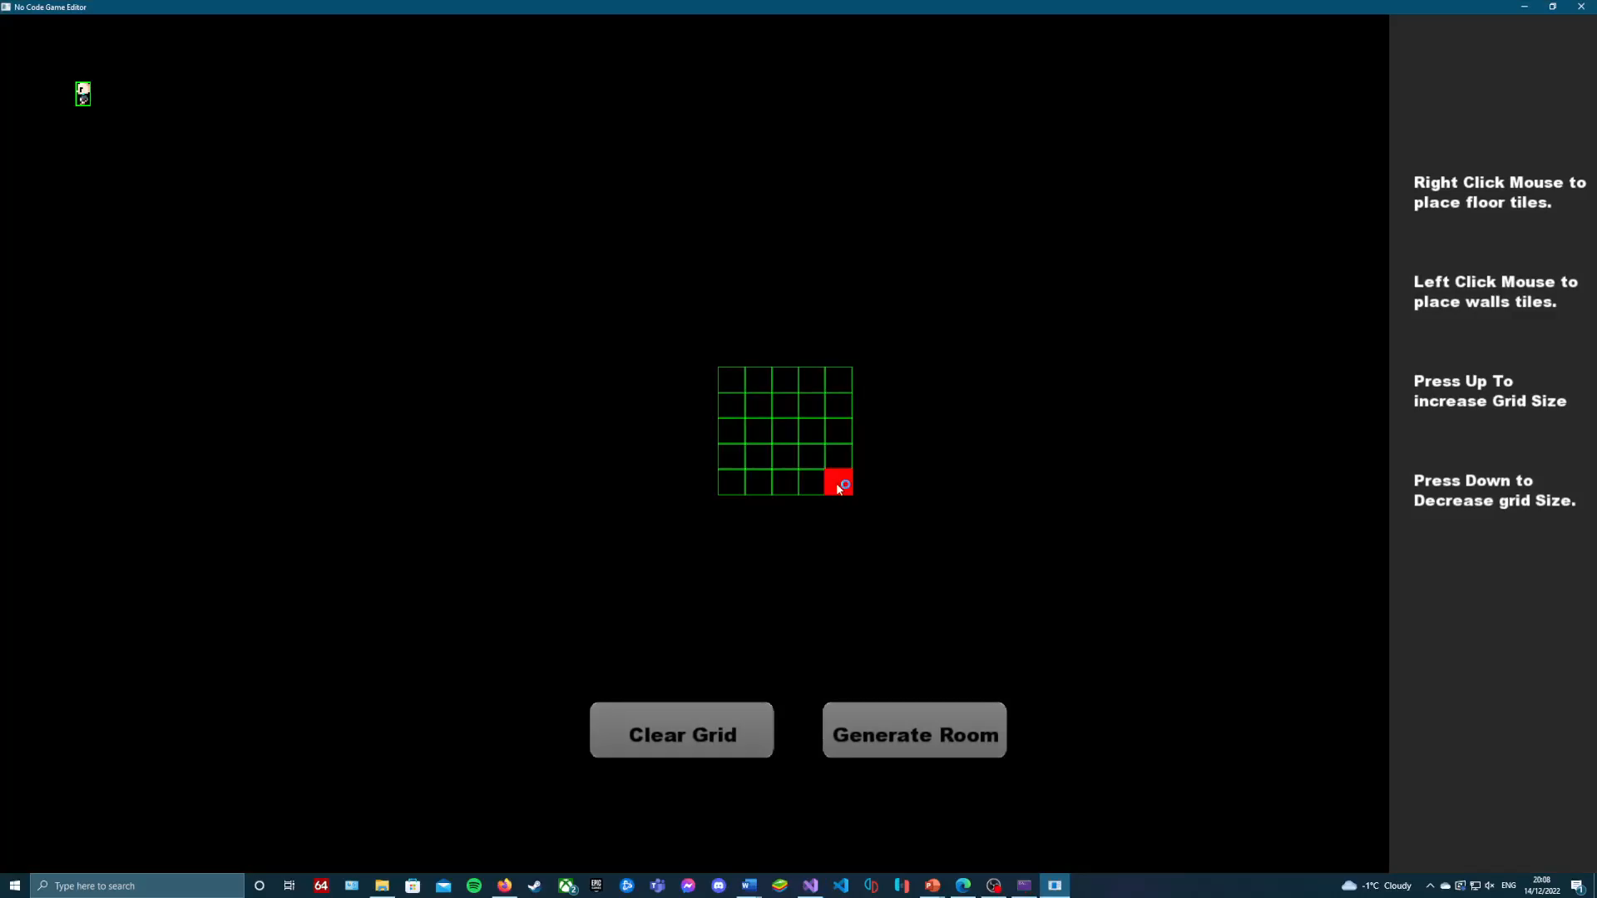
Demonstration
Progress to Date

Slide 13
Questions
Thank you for attention!
I welcome any Feedback and Questions you may have regarding my Project.

